Slide 1
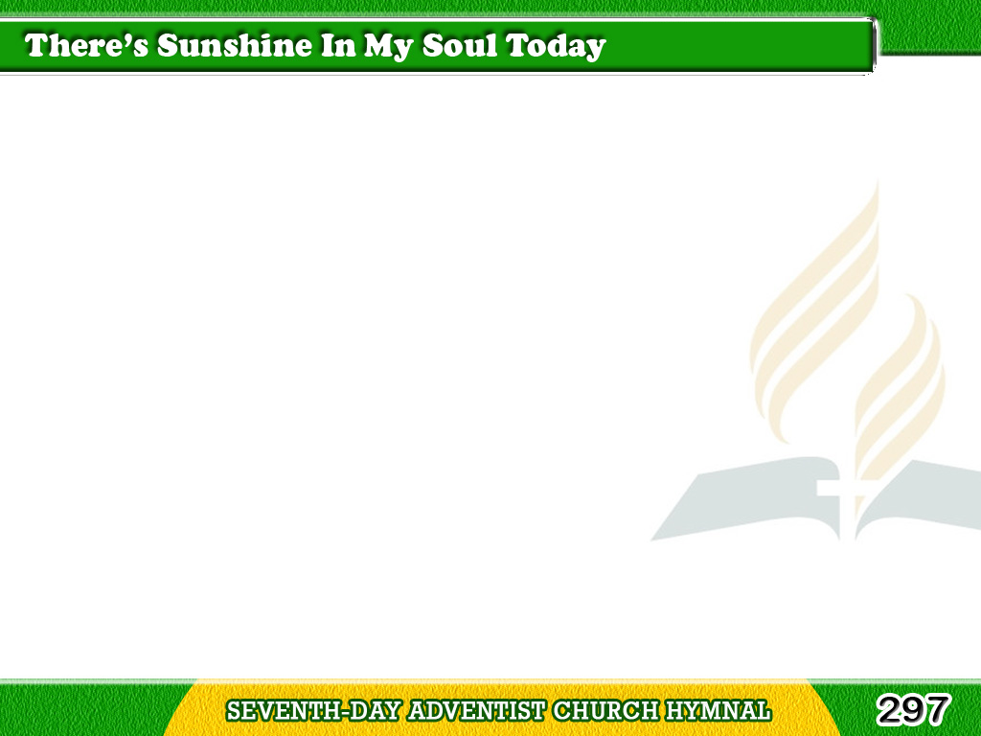
1/4
There’s sunshine
in my soul today,
More glorious and bright
Than glows in any earthly sky,
For Jesus is my light.
Tagalog
Version

Slide 2
1/4
Chorus
O there’s sunshine,
blessed sunshine,
When the peaceful,
happy moments roll,
Tagalog
Version

Slide 3
1/4
Chorus
When Jesus shows
His smiling face
There is sunshine
in the soul.
Tagalog
Version

Slide 4
2/4
There’s music in my soul today,
A carol to my King,
And Jesus, listening, can hear
The songs I cannot sing.
Tagalog
Version

Slide 5
2/4
Chorus
O there’s sunshine,
blessed sunshine,
When the peaceful,
happy moments roll,
Tagalog
Version

Slide 6
2/4
Chorus
When Jesus shows
His smiling face
There is sunshine
in the soul.
Tagalog
Version

Slide 7
3/4
There’s springtime
in my soul today,
For when the Lord is near,
Tagalog
Version

Slide 8
3/4
The dove of peace sings
in my heart,
The flowers of grace appear.
Tagalog
Version

Slide 9
3/4
Chorus
O there’s sunshine,
blessed sunshine,
When the peaceful,
happy moments roll,
Tagalog
Version

Slide 10
3/4
Chorus
When Jesus shows
His smiling face
There is sunshine
in the soul.
Tagalog
Version

Slide 11
4/4
There’s gladness
in my soul today,
And hope, and praise,
and love,
Tagalog
Version

Slide 12
4/4
For blessings
which He gives me now,
For joys “laid up” above.
Tagalog
Version

Slide 13
4/4
Chorus
O there’s sunshine,
blessed sunshine,
When the peaceful,
happy moments roll,
Tagalog
Version

Slide 14
4/4
Chorus
When Jesus shows
His smiling face
There is sunshine
in the soul.
Tagalog
Version

